Slide 1










Whiteboardmaths.com
7
2
1
5
© 2004 All rights reserved

Slide 2


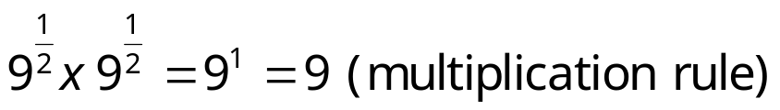
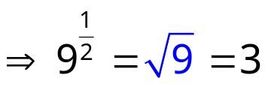
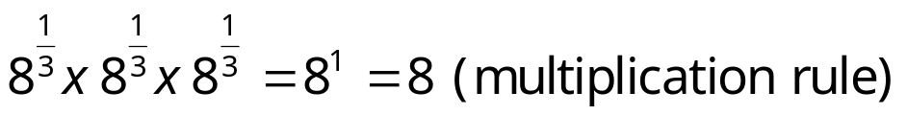
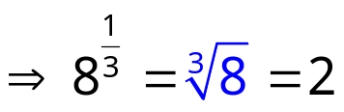
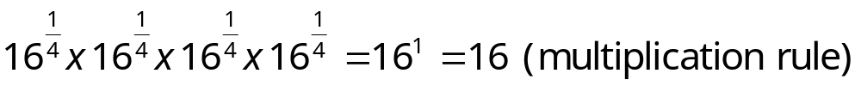
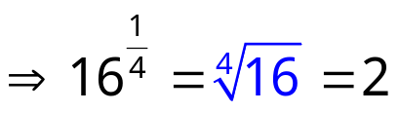
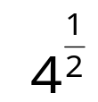
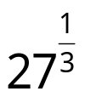
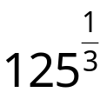
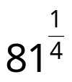
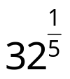



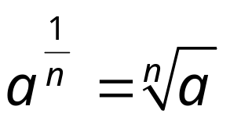
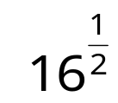
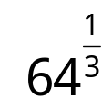
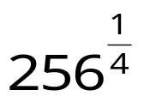
Fractional Indices
Multiplication Rule
a^{m} x a^{n} = a^{m+n}
a⁰ = 1
Division Rule
a^{m} ÷ a^{n} = a^{m-n}
Power Rule
(a^{m})^{n} = a^{mn}
Negative Index Rule
Consider the following:
Evaluate the following:
Write in index form:
So in general:
2
3
5
3
2

Slide 3

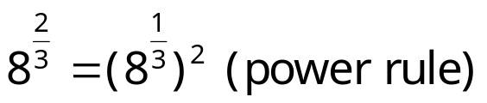
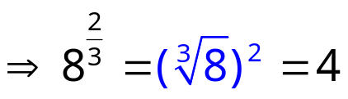
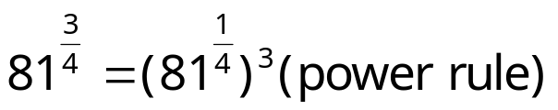
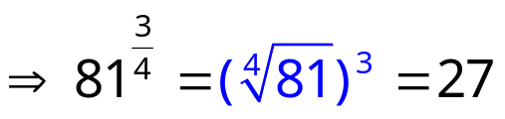
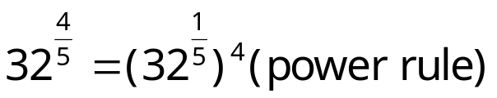
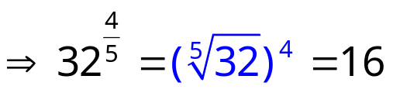
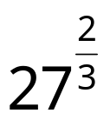
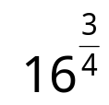
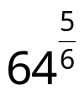
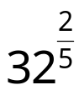
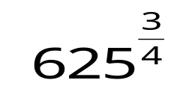
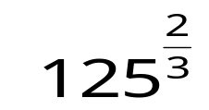
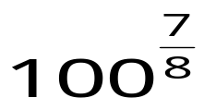
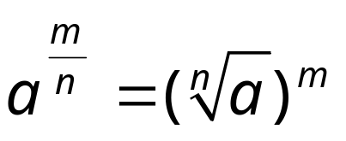



Fractional Indices
Multiplication Rule
a^{m} x a^{n} = a^{m+n}
Division Rule
a^{m} ÷ a^{n} = a^{m-n}
a⁰ = 1
Power Rule
(a^{m})^{n} = a^{mn}
Negative Index Rule
Unit Fraction Rule
Consider the following:
Evaluate the following:
Write in index form:
So in general:
9
8
32
4

Slide 4

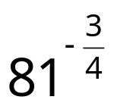
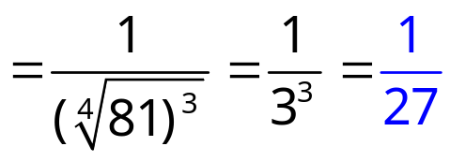
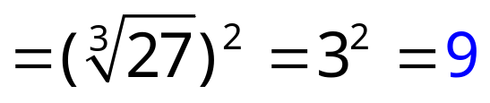
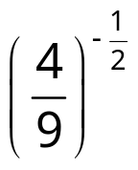
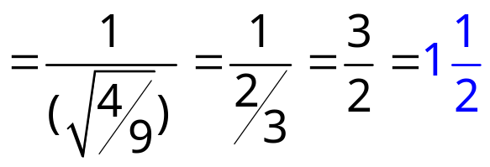

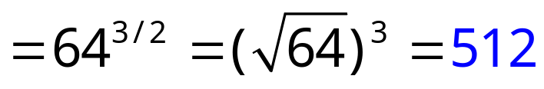
Fractional Indices
Multiplication Rule
a^{m} x a^{n} = a^{m+n}
a⁰ = 1
Division Rule
a^{m} ÷ a^{n} = a^{m-n}
Power Rule
(a^{m})^{n} = a^{mn}
Negative Index Rule
Unit Fraction Rule
General Fraction Rule
Evaluate the following:

Slide 5
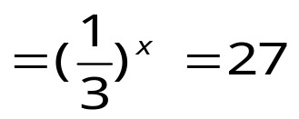
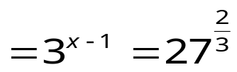
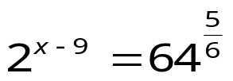
Equations Involving Indices
Multiplication Rule
a^{m} x a^{n} = a^{m+n}
a⁰ = 1
Division Rule
a^{m} ÷ a^{n} = a^{m-n}
Power Rule
(a^{m})^{n} = a^{mn}
Negative Index Rule
Unit Fraction Rule
General Fraction Rule
Solve the following:
6^{2x} = 36
⇒6^{2x} = 6²
⇒2x = 2
⇒ x = 1
⇒(3⁻¹)^{x} = 27
⇒ 3^{-x} = 3³
-x = 3
x = -3
⇒ 3^{x-1} = 9
⇒ 3^{x-1} = 3²
x - 1 = 2
x = 3
⇒2^{x-9} = 32
⇒ 2^{x-9} = 2⁵
x - 9 = 5
x = 14

